Slide 1





Leveraging Propagated Infection to Crossfire Mutants
Hang Du†, Vijay Krishna Palepu⋆, James A. Jones†
†University of California, Irvine, Irvine, USA
⋆Microsoft, Silicon Valley Campus, Mountain View, USA
2025.5.2
Ottawa, Canada

Slide 2

Leveraging Propagated Infection to Crossfire Mutants
Comprehension
Targeted
Justification
Human-written Tests
Integration

Slide 3
Test
Program

Slide 4
Program
Test Input
Test Oracle

Slide 5
Program
Test Input1
Test Oracle
Test Input2
Test Oracle
Test Input3
Test Oracle

Slide 6
Program
Test Input1
Test Oracle
Test Input2
Test Oracle
Test Input3
Test Oracle

Slide 7
Program
Test Input1
Test Oracle
Test Input2
Test Oracle
Test Input3
Test Oracle

Slide 8

balance
account
Program
Assertion Oracle
Test Input1
Test Oracle
Test Input2
Test Oracle
Test Input3
Test Oracle

Slide 9
Assertion Oracle
Mutant Program
Program
Test Input
Test Input1
Test Input
Test Input2
Test Input
Test Input3

Slide 10

Program
Test Input1
Assertion Oracle
Test Input2
Test Input3
Propagated
Infection
Mutant Program
Test Input1
RIPR model
[Nan Li, Jeff Offutt 2014]
Test Input2
Killed
Test Input3
Failed

Slide 11

Program
Test Input1
Assertion Oracle
Test Input2
Test Input3
Propagated
Infection
Mutant Program #2
Test Input1
RIPR model
[Nan Li, Jeff Offutt 2014]
Passed
Test Input2
Survived
Passed
Test Input3
Passed

Slide 12
Program
Test Input1
Assertion Oracle
Test Input2
Test Input3
Compare
Propagated
Infection
Mutant Program #2
Test Input1
RIPR model
[Nan Li, Jeff Offutt 2014]
Test Input2
Survived
Test Input3
Memory State Analysis

Slide 13
Program
Test Input1
Assertion Oracle
Test Input2
Test Input3
Compare
Propagated
Infection
Mutant Program #2
Test Input1
RIPR model
[Nan Li, Jeff Offutt 2014]
Test Input2
Survived
Test Input3
Memory State Analysis

Slide 14

Program
Test Input1
Assertion Oracle
Test Input2
Test Input3
Propagated
Infection
Mutant Program #2
Test Input1
RIPR model
[Nan Li, Jeff Offutt 2014]
Test Input2
Killed
Failed
Test Input3
New Assertion Oracle
Assertion Amplification

Slide 15
t1
t2
t3
Assertion Oracle
m1
t1
t2
t3
m2
t1
Propagated
Infection
t2
t3
RIPR model
[Nan Li, Jeff Offutt 2014]
m3
t1
t2
t3
m4
New Assertion Oracle
t1
t2
t3

Slide 16
t1
t1
t2
t2
t3
t3
Assertion Oracle
m1
m1
t1
t1
t2
t2
t3
t3
m2
m2
t1
t1
t2
m1,m2,m4
Propagated
Infection
t2
t3
t3
RIPR model
[Nan Li, Jeff Offutt 2014]
m3
m3
Mutant Crossfiring (William, Smith 2007)
t1
t1
t2
t2
t3
t3
m4
m4
t1
New Assertion Oracle
t1
t2
t2
t3
t3

Slide 17
Technique
amplify assertions to kill surviving mutants
- Optimizations:
simple assertions
efficient killing
Theoretical Foundations and Practical Implementations
crossfire model
- Empirical Results:
number of killable surviving mutants
options to kill surviving mutants
crossfire efficiency

Slide 18


Experiment
10 Open-source Java Projects
PIT
~ 1.2 Million Mutated Test Runs
~ 50,000 Total Mutants
~ 13,000 Surviving Mutants

Slide 19
Results
Impact
Crossfire

Slide 20

Surviving: 288
Killable: 243
Engineered, verified, and documented within a few hours in the same day!
20 min * 243 ≈ 81 hours
≈ 10 working days!

Slide 21

- Desirability
- Interfaces
- Killing Strategies - Integration
🧠 Key Insight: All these directions require us to rethink how targeted improvements can be strategically integrated into existing test suites and how we can amplify human-written tests in a smart and meaningful way.

Slide 22
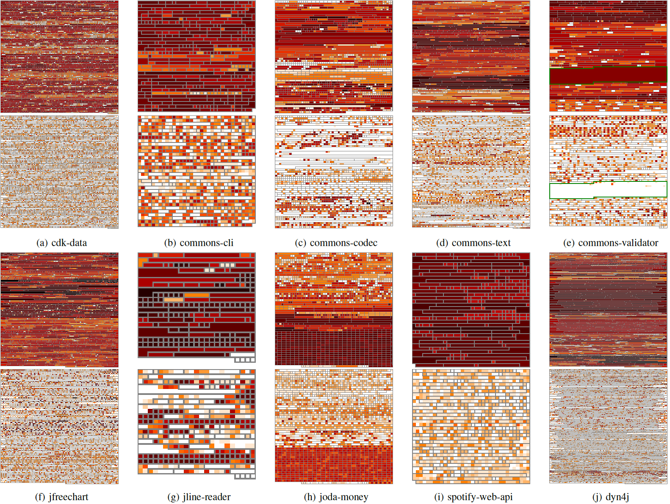

Mutant Crossfire Phenomenon

Slide 23
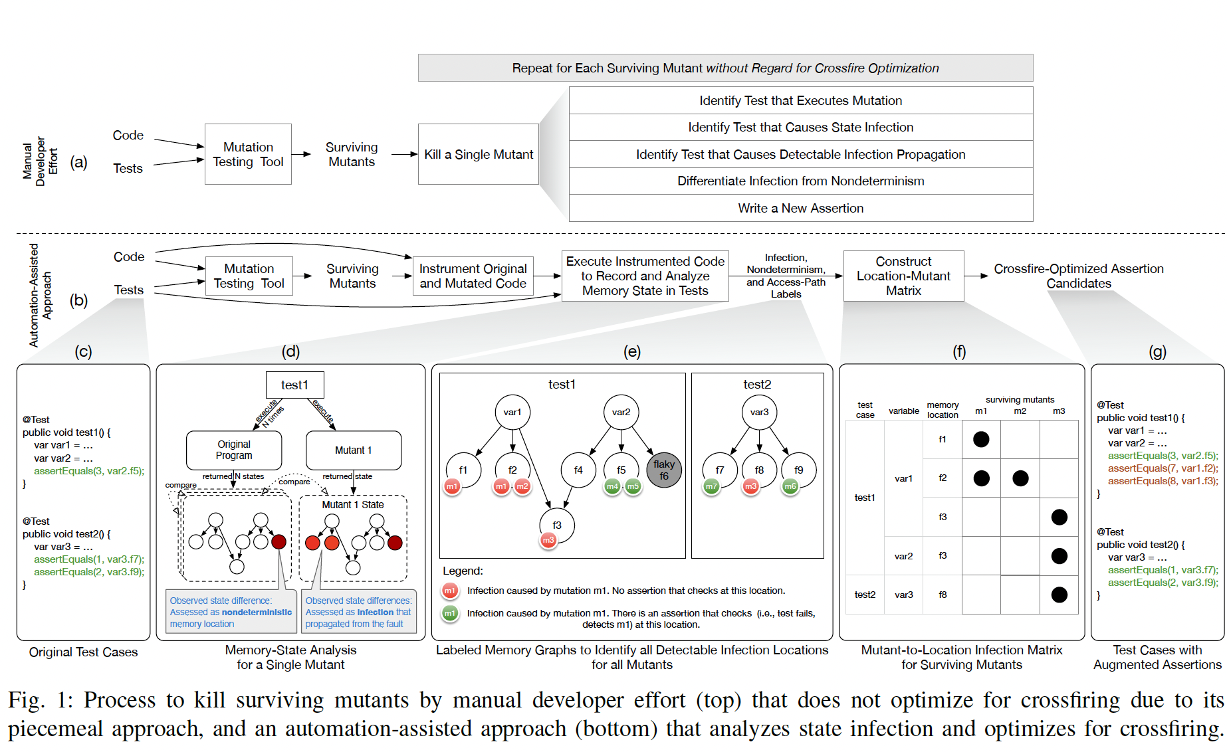

Slide 24
Leveraging Propagated Infection to Crossfire Mutants
Avg. 42% (19%-84%) of surviving mutants killable through assertion amplification
Avg. improving ~1 test with ~2 assertions kill ~6 surviving mutants

